Slide 1
ABC School Registration Platform
Brad Gordillo
CST 499: Capstone for Computer Software Technology
Amr Elchouemi
April 4th, 2022

Slide 2
Overview
Project Overview
SRS Document
UML Design
Landing Page, Login, Enrollment page review
Database review
php code overview

Slide 3
Project Overview
Goal: To create a website where students to register for courses on their own time.
The popularization of education has increased and the proportion of enrolment in colleges is increasing year over year (Wang, Y., Jiao, L., & Liu, C. (2021).

Slide 4
SRS Overview (Software Requirements Specification)
The Software Requirements Specification documents is one of the most important documents in the improvement process (Raiker, S., Cholli, N.G.; 2021)
Provides an overview of the purpose of the software
Expresses the backend systems as well as the user interface
Covers functional and nonfunctional requirements
Functional: User registration + Course Registration

Slide 5
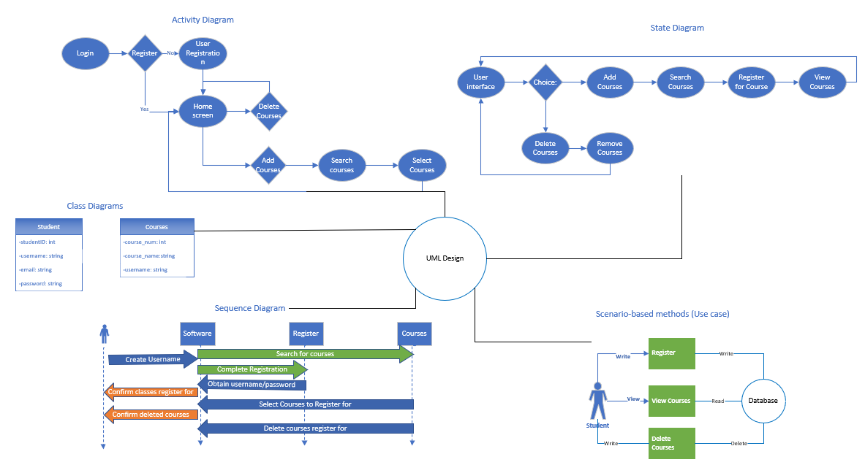
UML Design

Slide 6
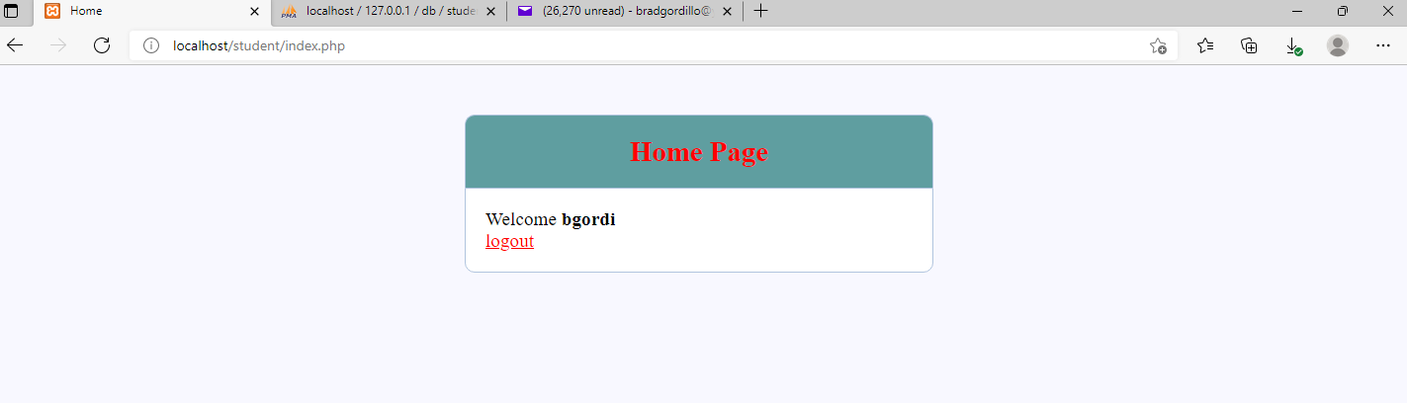
Landing Page
Landing Page (once user is logged in)

Slide 7
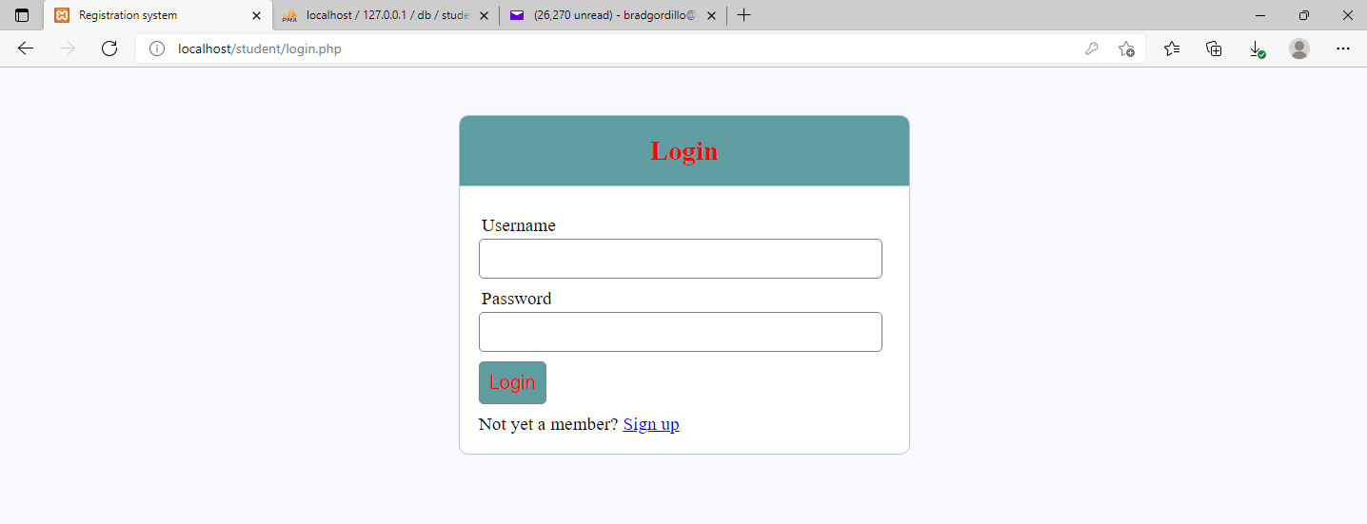
Login Page
Login Page

Slide 8
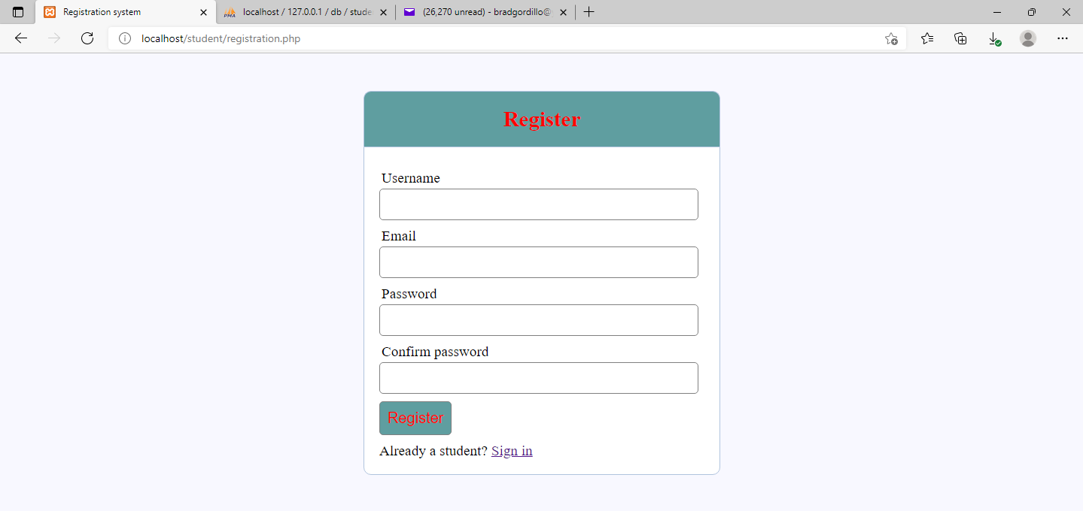
Enrollment Page (Registration Page)
Registration page

Slide 9
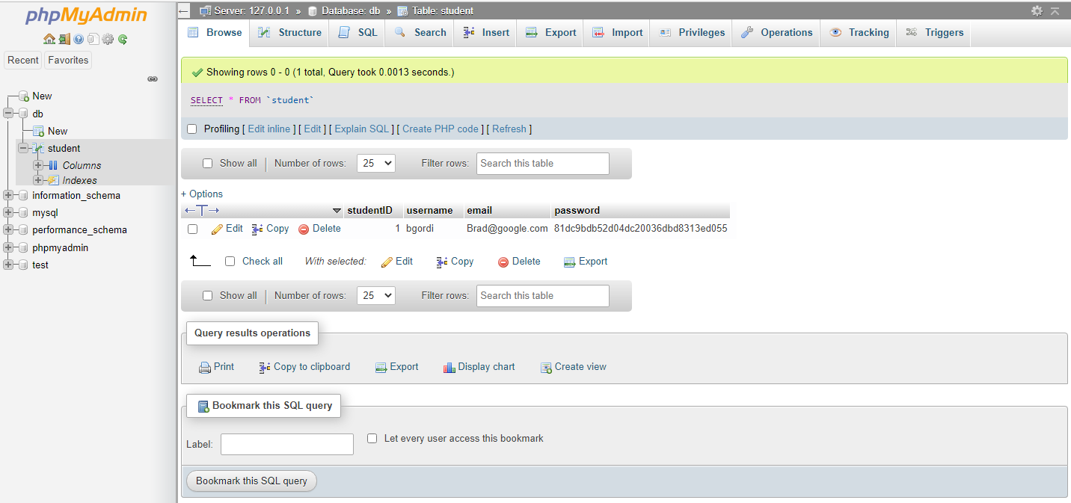
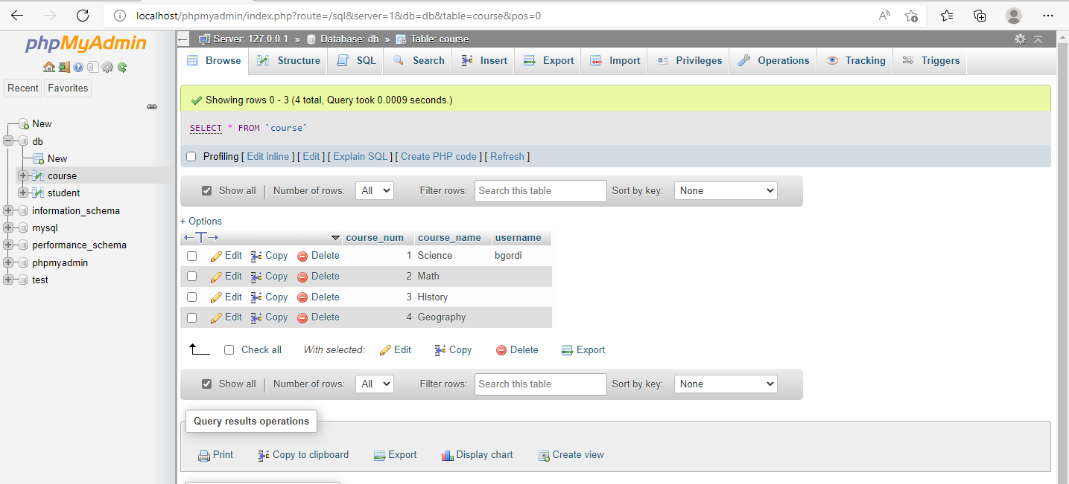
Database Review
Student Database
Course Database

Slide 10
Php code Overview
7 Total .php files for the initial launch.
(1) covering when errors occur
(1) index file that will be the landing page
(1) handling the login
(1) handling the registration and connecting to the server
(1) set for the removing of classes
(1) set up for connection to the server
(1) css file that provides the style for the site

Slide 11
Resources
Wang, Y., Jiao, L., & Liu, C. (2021). Analysis of College Student Registration Management and Change Prediction Based on Mutated Fuzzy Neural Network Algorithm. Computational Intelligence & Neuroscience, 1–9. https://doi.org/10.1155/2021/7097425
Raikar, S., & Cholli, N. G. (2021). An Analysis of Ambiguity Detection Techniques for Software Requirement Specification. 2021 IEEE International Conference on Computation System and Information Technology for Sustainable Solutions (CSITSS), Computation System and Information Technology for Sustainable Solutions (CSITSS), 2021 IEEE International Conference On, 1–4. https://doi.org/10.1109/CSITSS54238.2021.9683497

